Slide 1

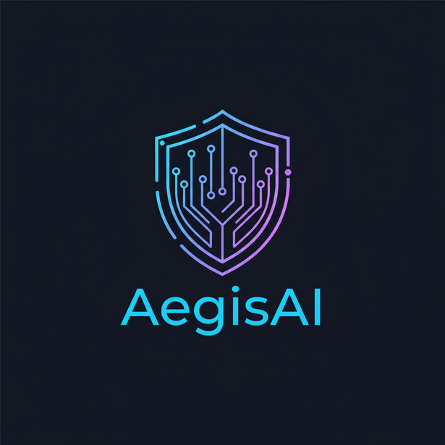
AEGIS AI
predict protect evolve

Slide 2

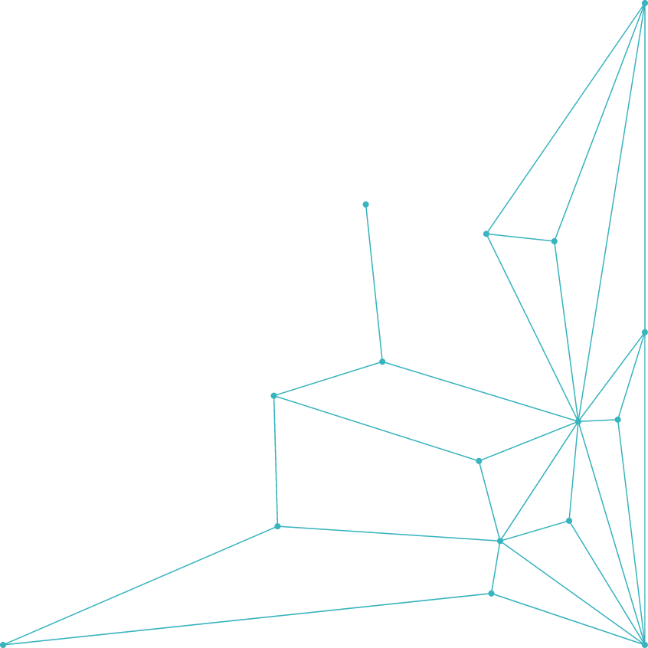
BY
NEXTGEN
DARAQSHAN FATIMA (Team lead)
SYEDA GULFISHAN FATIMA
SHIFA CHISTHI
NAJWA JUHANA FATIMA
NABEELA HAMEEDA
SAMAANAH ABDUS SALAAM
2

Slide 3
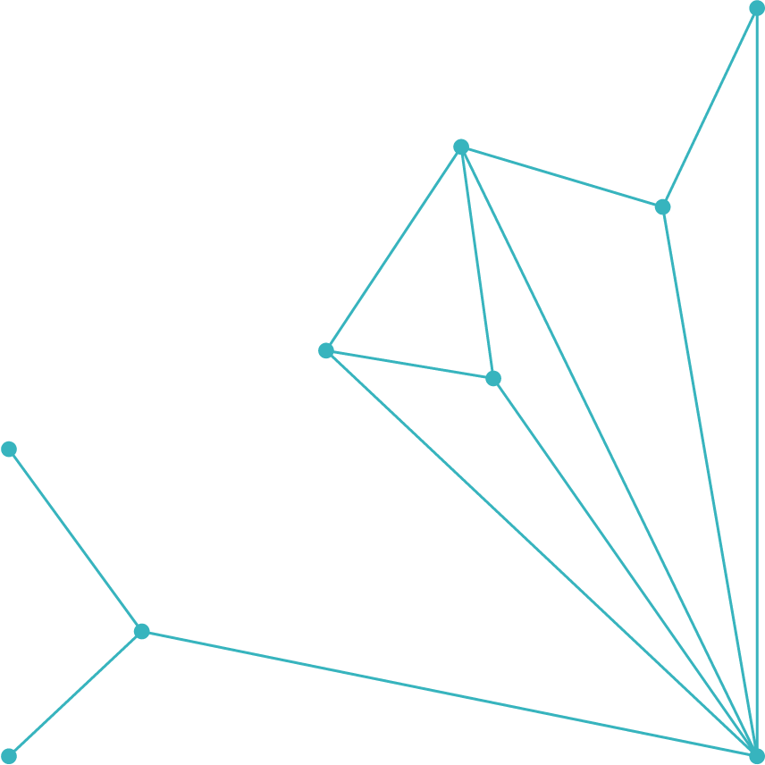




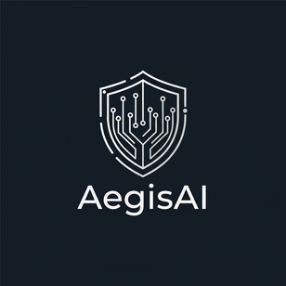


SNAPSHOT
THE PROBLEM
OUR SOLUTION
KEY FEATURES
MVP DEMO
Real-Time
WHY AEGIS AI IS DIFFERENT
Tech stack
CONCLUSION
3

Slide 4

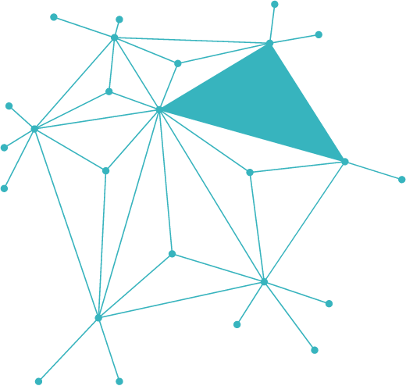
THE PROBLEM
Imagine a growing company with sensitive data is surrounded by thousands of new cyber threats emerging every single day. Yetmost security tools only raise alarms after the damage is done. Teams are forced to react instead of prepare. Simulation platforms, if they exist, are either too complex or too expensive to use. A single overlooked configuration can open the door to devastating breaches.
This leads to:
Costly financial losses from breaches 💸
Damaged trust and reputation 🔓
Downtime and disrupted operations ⏳
Lack of preparedness for evolving threats ⚠️
Legal penalties and compliance issues ⚖️
Sensitive data theft and misuse 🕵️‍♂️
Increased stress on IT/security teams 😓
Lost customers and missed opportunities 🚪
4

Slide 5

OUR SOLUTION:AEGIS AI
AegisAI is a cyber defense platform designed to outsmart evolving threats. It continuously learns from every attack, adapts in real time, and strengthens itself with each encounter. With its intelligence, speed, and simplicity, AegisAI safeguards sensitive data, maintains trust, and ensures smooth business operations without interruption. It’s more than just protection—it’s an evolving shield for the digital age.It can easily manage
Detect threats in real time before they cause harm
Predict future attacks using intelligent algorithms
Respond instantly with automated countermeasures
Adapt continuously by learning from every incident
Protect data and trust with reliable security
Simplify control through an easy-to-use dashboard
5

Slide 6




KEY FEATURES
Real-time Threat Detection
Predictive Defense
Automated Response
Adaptive Learning
Anomaly Detection
Scalable Security
Data Protection
Cloud Integration
User-Friendly Dashboard
24/7 Monitoring
6
Raleway
Raleway Dots

Slide 7
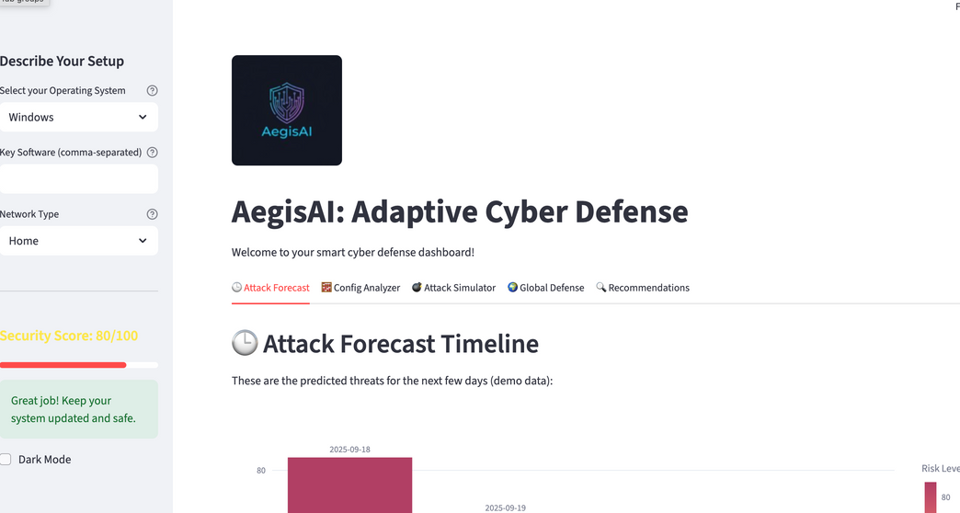
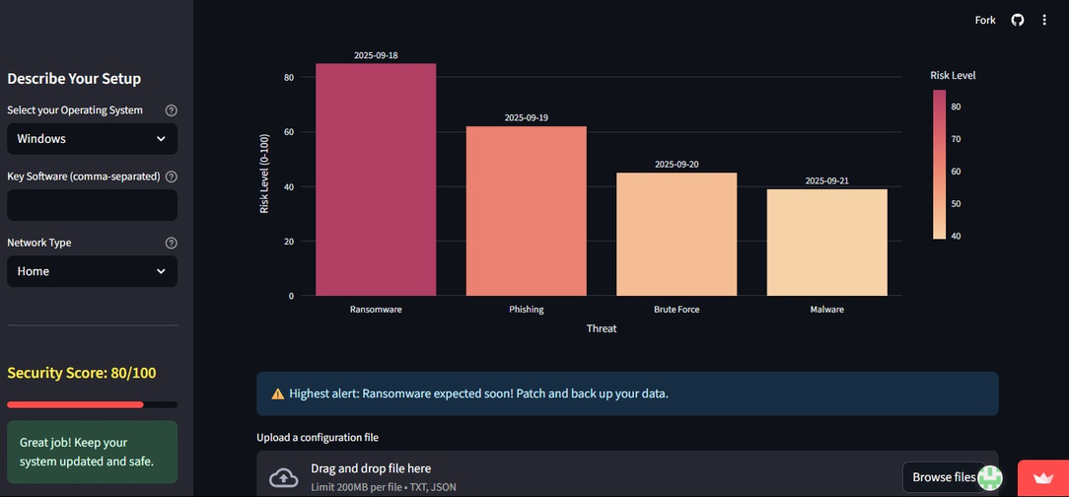
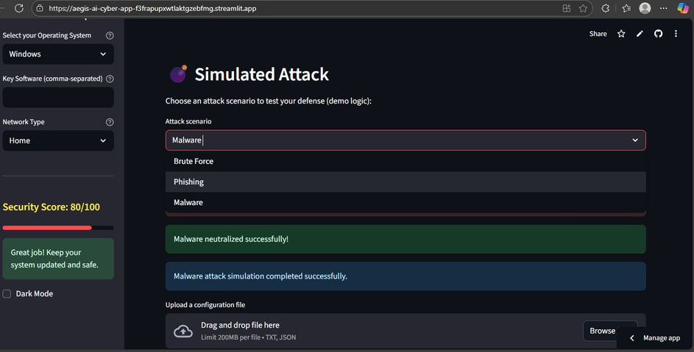
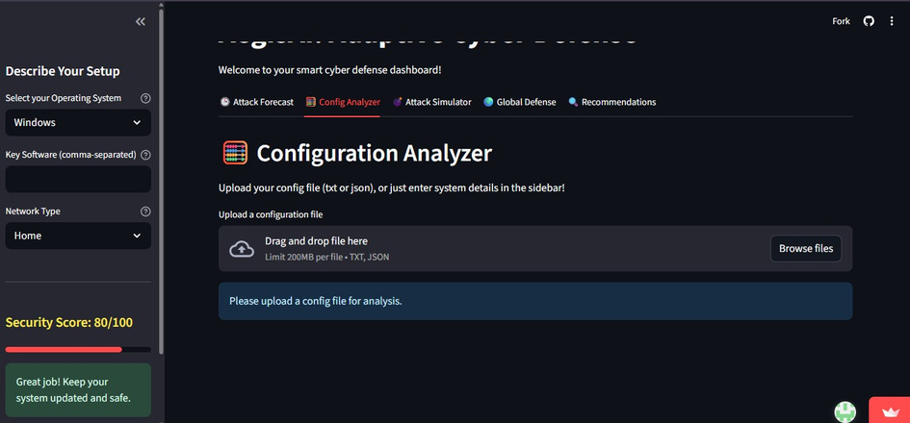

DEMO MVP
AegisAI Demo Dashboard – Predictive Cyber Defense”
Upcoming risks detected: Patch, protect & stay safe."
7
Scans and analyzes system or network configuration
lets users test how their system would react to different scenarios

Slide 8
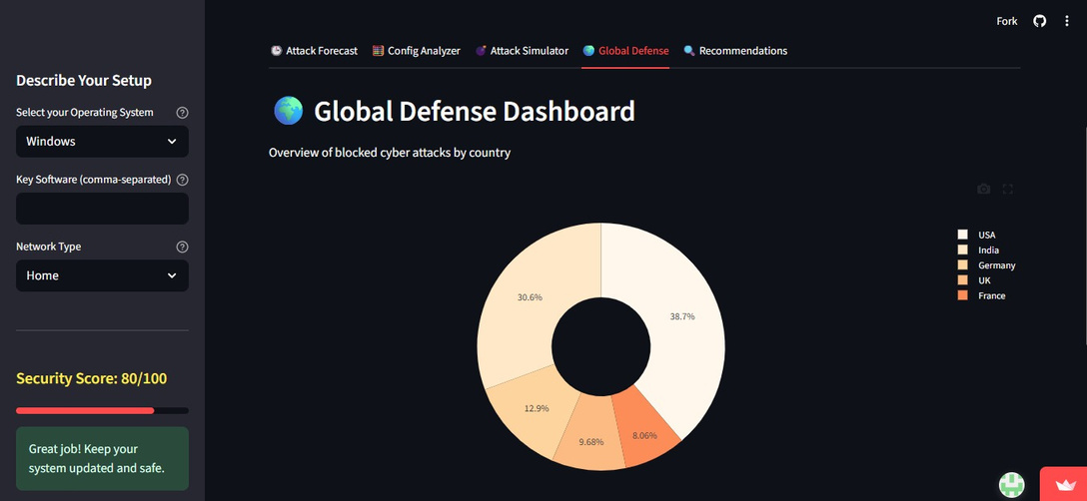
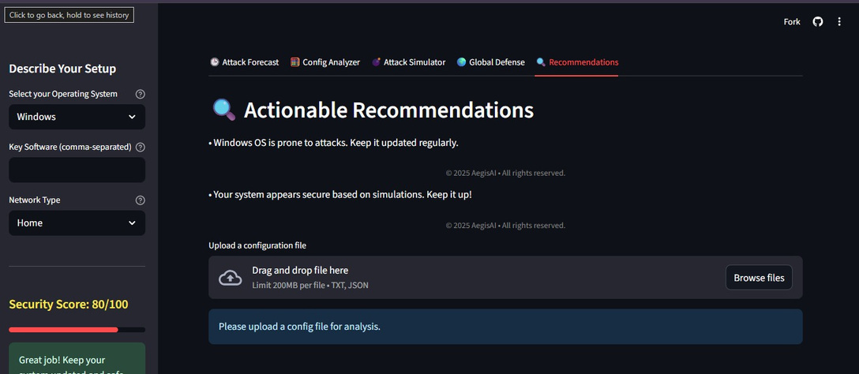
A visual chart representing the distribution of blocked cyberattacks by country
Translates all the analysis,simulations, and defense monitoring into clear, easy to follow security advice for the user
8

Slide 9

WHAT MAKES AEGIS AI DIFFERENT?
Unlike traditional cyber defense tools that remain static and slow to adapt, AegisAI is built to evolve. It doesn’t just defend—it predicts, learns, and responds in real time. By combining intelligence, automation, and simplicity, AegisAI offers security that grows stronger with every challenge, ensuring businesses stay one step ahead of attackers
.
What Makes It Different:
Adaptive Defense – Learns and evolves with every attack
Predictive Intelligence – Anticipates and blocks threats early
Automated Speed – Responds instantly, faster than humans
Unified Security – Protects endpoints, networks, and cloud seamlessly
Simplicity with Power – Easy dashboard, deep protection

Slide 10
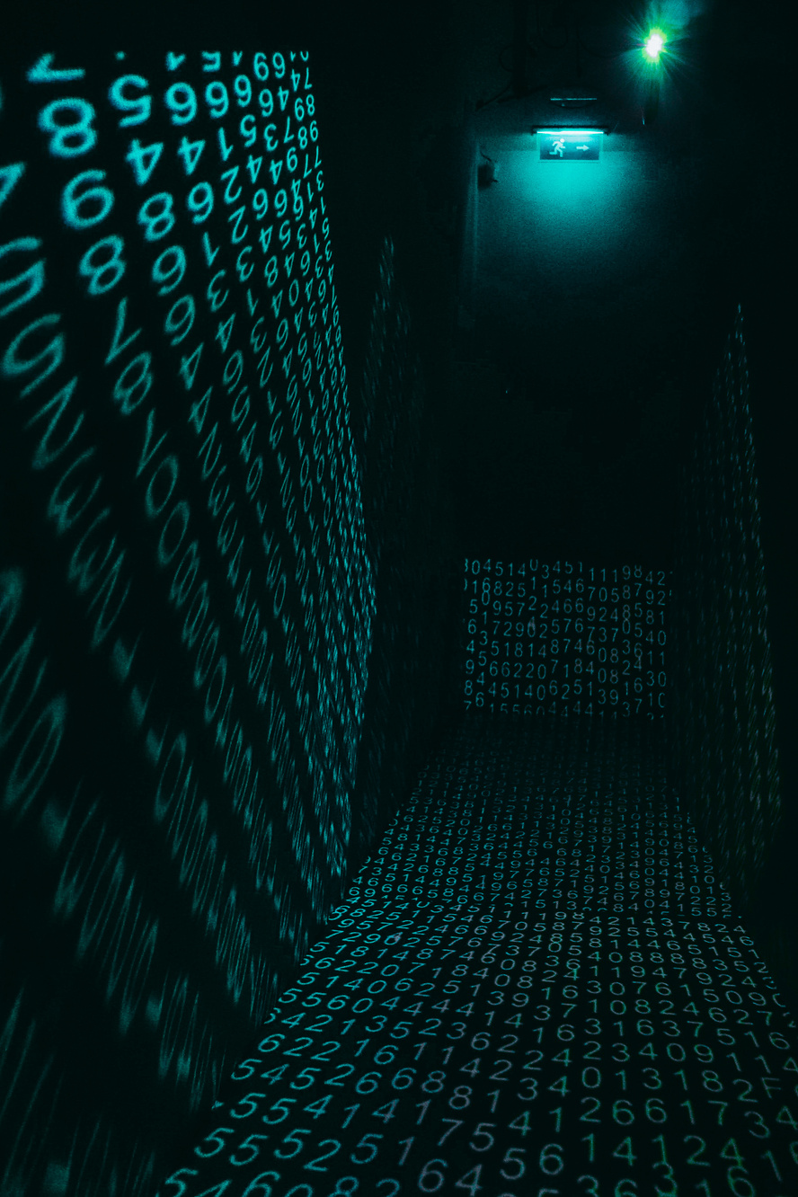
TECH STACK
AI & Machine Learning – TensorFlow, PyTorch
Data Processing – Apache Kafka, Spark
Backend – Python, Node.js, FastAPI
Frontend/Dashboard – React.js, Next.js
Databases – PostgreSQL, MongoDB, ElasticSearch
Cloud & Infrastructure – AWS, Azure, GCP, Docker, Kubernetes
Security Frameworks – OpenSSL, OAuth 2.0, JWT
Monitoring & Logging – Prometheus, Grafana, ELK Stack
Version Control & CI/CD – GitHub, GitLab CI, Jenkins
APIs & Integrations – REST, GraphQL
2.
10

Slide 11
Conclusion
In today’s world where cyber threats are evolving faster than ever, traditional defense systems are no longer enough. AegisAI stands apart as an intelligent, adaptive, and predictive defense platform that not only protects but also evolves with every challenge. By blending AI, automation, and simplicity, AegisAI empowers businesses to safeguard their data, maintain trust, and operate fearlessly in the digital age.
Why Choose Us? Because AegisAI doesn’t just defend—it evolves, ensuring your security is always one step ahead of the threat.

